Slide 1




MA2540 APPLIED STATISTICS
A STATISTICAL STUDY ON ATTENDANCE IN IIT HYDERABAD

Slide 2


Overview
Introduction | 3
Normality Test | 6
Visualisations | 8
Correlation | 12
Confidence Intervals | 17
Hypothesis Test | 28
Chi-Square Test | 39
Conclusion | 42

Slide 3
INTRODUCTION

Slide 4


This study at IITH explores factors influencing student attendance, using survey data to understand engagement and success, including course load, class timing, and demographics.
We distributed a Google Form questionnaire to IIT Hyderabad students to collect sample data for statistical analysis.
To boost participation, we sent frequent reminders and ensured survey anonymity. This effort yielded 259 valid responses, forming a strong dataset for our study.
About Our Data

Slide 5


Around 50 responses from Google Forms were discarded due to inconsistencies, like CGPA values exceeding 10 or reaching 10 after the 3rd semester, which is unlikely.
Certain responses showed localized inconsistencies, leading to the substitution of erroneous values with the mean derived from validated data points.
The initial dataset of 300 responses was refined to a final dataset of about 260 authentic responses after thorough data cleaning and preprocessing.
Preprocessing

Slide 6
NORMALITY
TESTS

Slide 7


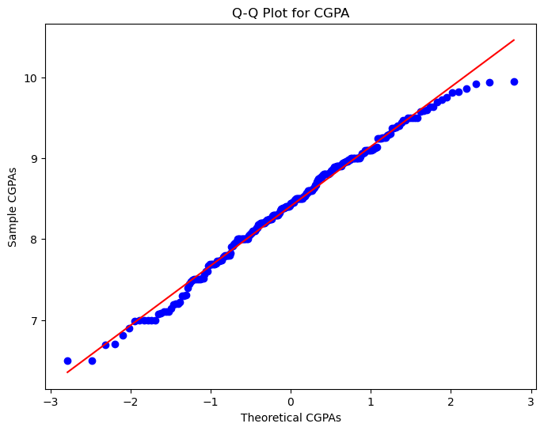
Shapiro – Wilk Test
After conducting the Shapiro-Wilk test and observing a test-statistic of approximately 0.98 with a p-value of about 0.049, we verified our inference using a Q-Q' plot. The close alignment of datapoints with the linear line suggests that the CGPA of students likely follows a normal distribution. Hence, the dataset can be considered to originate from a normal distribution.
Q – Q’ Plot for CGPA

Slide 8
VISUALISATIONS

Slide 9
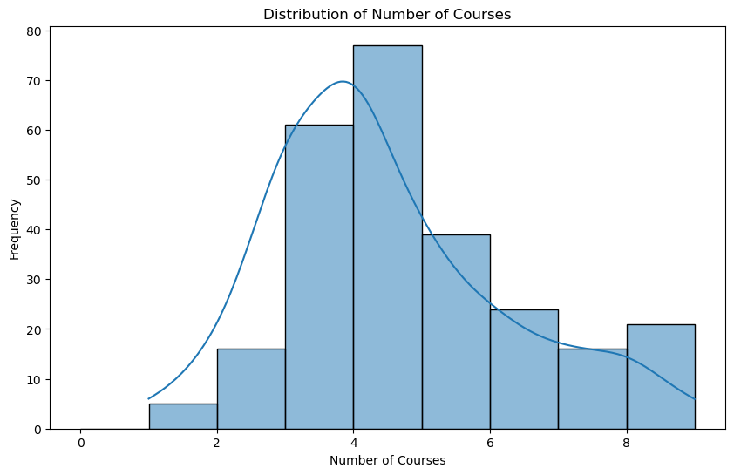
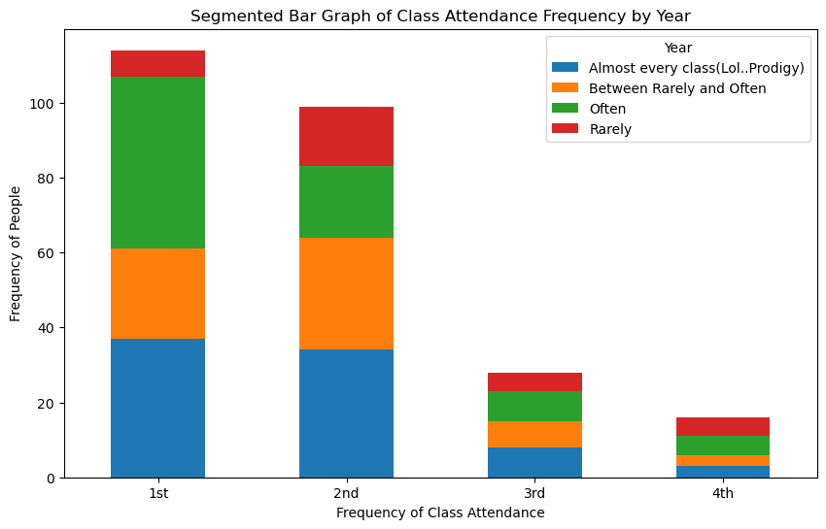
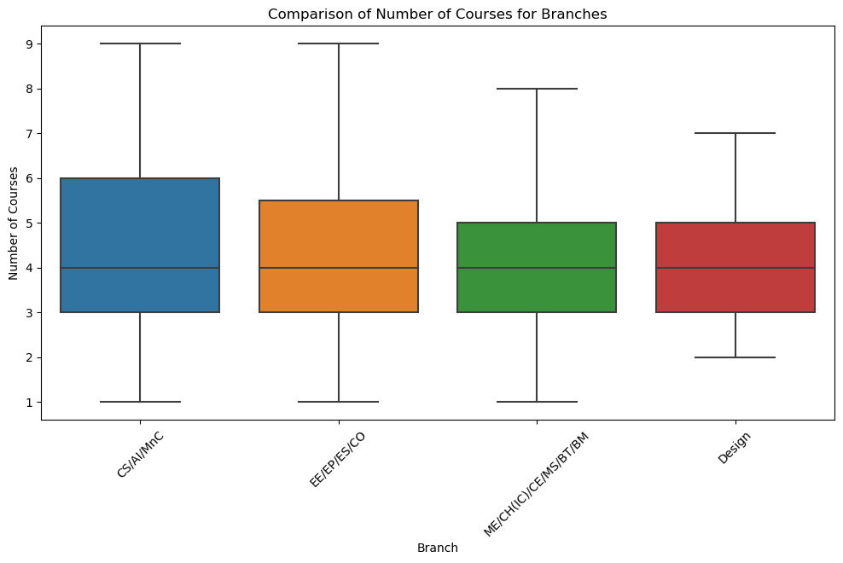

Slide 10

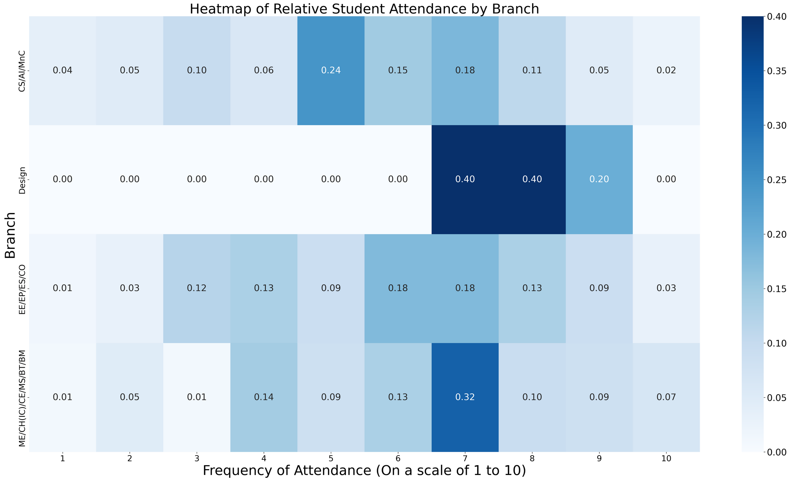
Heatmap
The heatmap shows branch-wise attendance across classes, scaled from 1 to 10. Dark green shades indicate higher attendance, light green shades lower.

Slide 11

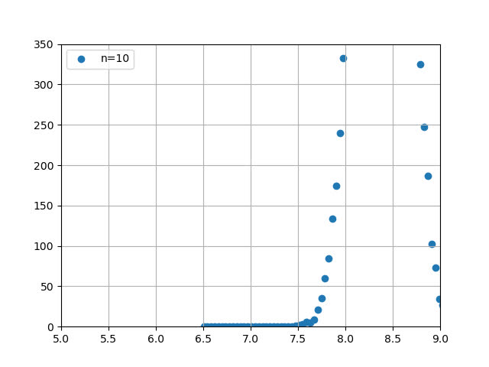
Central Limit Theorem

Slide 12
CORRELATIONS

Slide 13
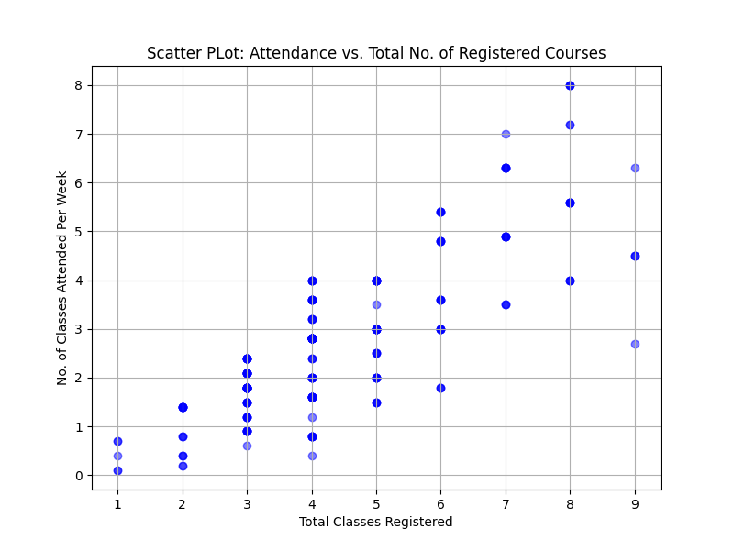
Correlation Between No. Of Total Course Registered And Attendance
Sample Correlation Coefficient
ΣX
:
Sum of values of X
Var(X)
:
Variance of X
Cov(X, Y)
:
Covariance of X and Y

Slide 14
Correlation Between No. Of Total Course Registered And Attendance
The correlation coefficient ranges between -1 and 1:
-
indicates a perfect positive linear relationship
-
indicates no linear relationship between X,Y
-
indicates a perfect negative linear relationship
Conclusion:
-
Indicates a strong linear relationship between Attendance and No. of course Registered

Slide 15
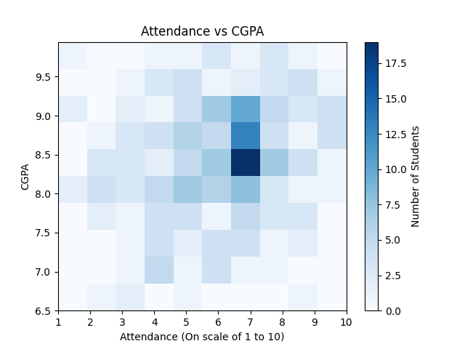
Correlation Between Attendance And Academic Performance
Sample Correlation Coefficient
ΣX
:
Sum of values of X
Var(X)
:
Variance of X
Cov(X, Y)
:
Covariance of X and Y

Slide 16
Correlation Between Attendance And Academic Performance
The correlation coefficient ranges between -1 and 1:
-
indicates a perfect positive linear relationship
-
indicates no linear relationship between X,Y
-
indicates a perfect negative linear relationship
Conclusion:
-
Almost negligible correlation coefficient
Non-linear correlation between Attendance and CGPA

Slide 17
CONFIDENCE
INTERVALS

Slide 18
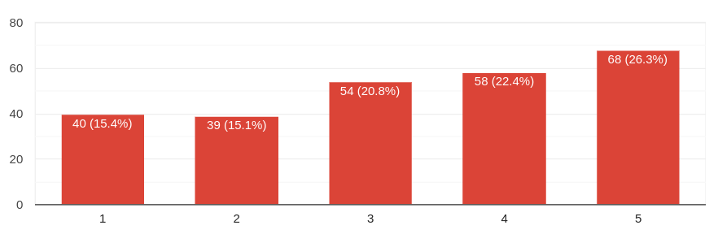
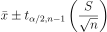
Confidence Interval for mean attendance in classes with gap in between.
CI of the mean when sigma is unknown is given by,

Slide 19
Confidence Interval for mean attendance in classes with gap in between.
CI of the mean when sigma is unknown is given by,
On solving we obtain,
We're 95% confident that students with time gaps between classes have an attendance likelihood between 3.119 and 3.461 on a 1 to 5 scale.

Slide 20
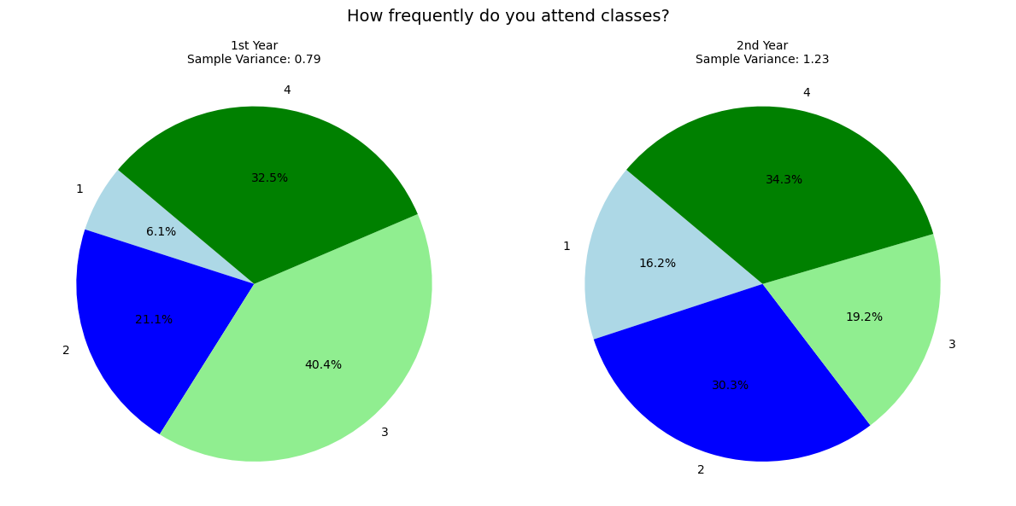
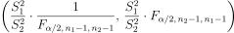
Confidence Interval for Variance Ratio of 1st and 2nd Year Students' Class Attendance
CI for ratio of population variance is given by,
The Frequency of Attendance - 1st year vs 2nd year

Slide 21
Confidence Interval for Variance Ratio of 1st and 2nd Year Students' Class Attendance
CI for ratio of population variance is given by,
On solving we obtain,
The Frequency of Attendance - 1st year vs 2nd year
We are 95% confident that ratio of variances of frequency of 1st and 2nd year students attending the classes lies in this interval.

Slide 22
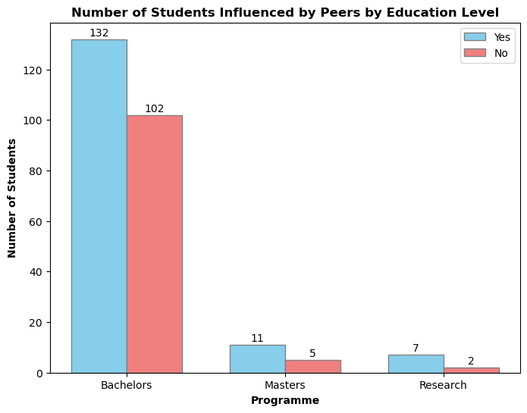
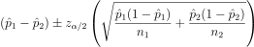
Confidence Interval for Proportional Disparity in Attendance: UG vs. PG Students
Confidence Interval for Difference in Proportions

Slide 23
Confidence Interval for Proportional Disparity in Attendance: UG vs. PG Students
Confidence Interval for Difference in Proportions
On solving we obtain,
With confidence level 99%, we can say that proportions of UG student effected by peers is same those of PGs.

Slide 24
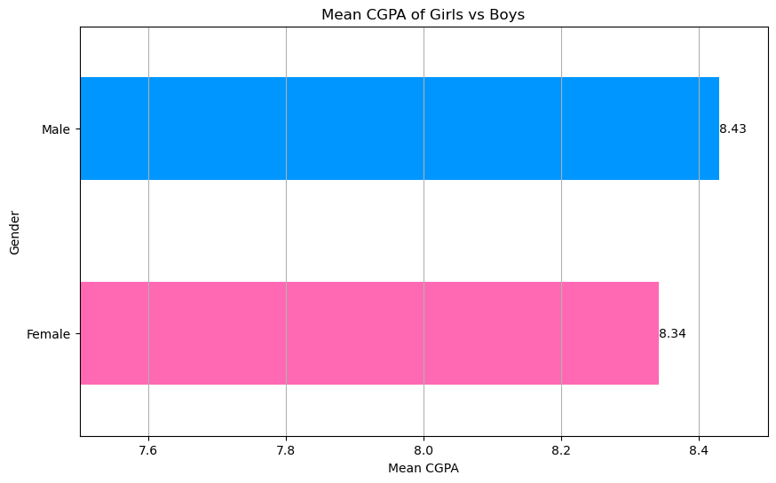
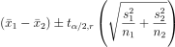
Confidence Interval for Difference in mean CGPA: Male vs Female
CI for Difference in Population means is given by,
Mean CGPA- Male vs Female

Slide 25
Confidence Interval for Difference in mean CGPA: Male vs Female
CI for Difference in Population means is given by,
On solving we obtain,
Mean CGPA- Male vs Female
With 99% confidence, we can say that difference between the mean CGPA of female and male students lies in this interval.

Slide 26
HYPOTHESIS
TESTING

Slide 27
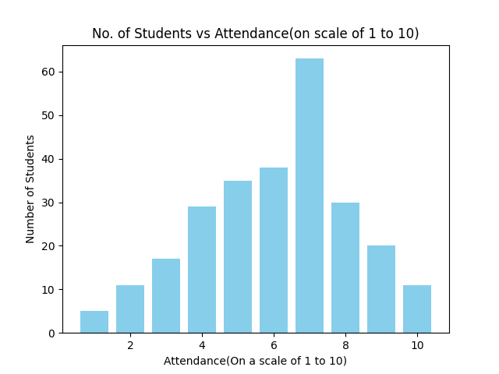
Hypothesis Testing For Average Student Attendance
Null Hypothesis:
Alternate Hypothesis:
µ is the average student attendance

Slide 28
Hypothesis Testing For Average Student Attendance
Conclusion:
Since our test statistic,
we reject the null hypothesis (H0)
Hence, we conclude that an average student attends more than 50% of the classes.

Slide 29
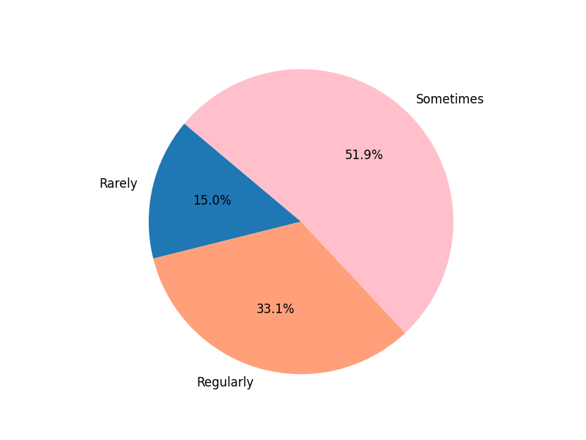
Hypothesis Testing for Influence of Exam Scores on Attendance
Null Hypothesis:
Alternate Hypothesis:
p is the proportion of students who gets influenced after getting low score in exams
Fig: Percentage of Students who attend more classes after getting a low score

Slide 30
Hypothesis Testing for Influence of Exam Scores on Attendance
Conclusion:
Since our test statistic,
we reject the null hypothesis
Hence, we can conclude that more than 33% of the IIT-H student population attends more classes after getting a low score in previous quiz/mid-sem
Fig: Percentage of Students who attend more classes after getting a low score

Slide 31
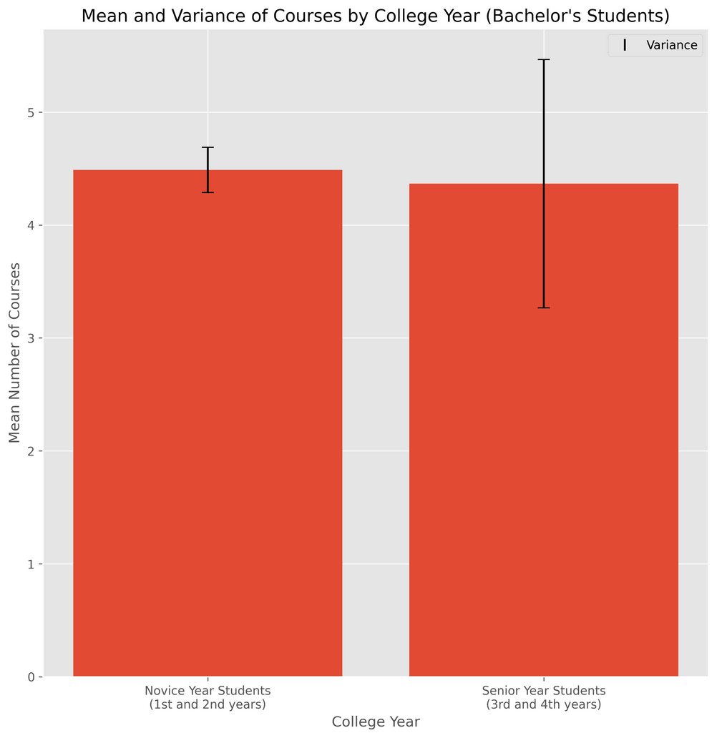
Hypothesis Testing for Variation in Number of Courses of Freshers & Seniors
Null Hypothesis:
Alternate Hypothesis:
sigma is the variance in no. of courses taken
Fig: Mean no. of courses by college year

Slide 32
Hypothesis Testing for Variation in Number of Courses of Freshers & Seniors
Conclusion:
We get,
so we reject the null hypothesis
Thus, we conclude that senior year (3rd and 4th Year) students have more variation in number of courses taken compared to the novice year (1st and 2nd Year) students
Fig: Mean no. of courses by college year

Slide 33
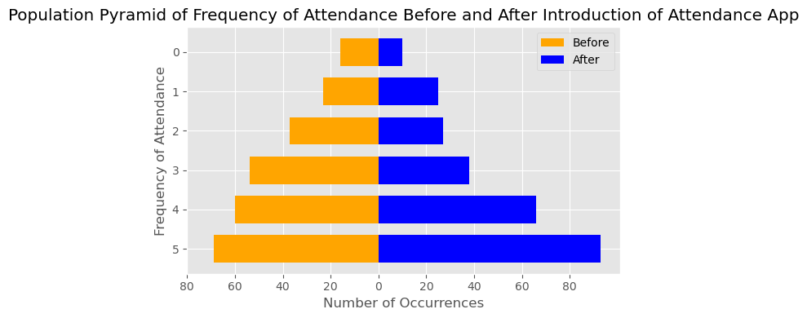
Hypothesis Testing for Dependent Samples: Attendance app effect
Null Hypothesis:
Alternate Hypothesis:
μD is mean difference for dependent samples
Fig: Bar graph showing the difference in attendance before and after launch of app

Slide 34
Hypothesis Testing for Dependent Samples: Attendance app effect
Conclusion:
-
We can reject the null hypothesis
Therefore, we conclude that there is an increase in attendance after the launch of the attendance app.
Fig: Bar graph showing the difference in attendance before and after launch of app

Slide 35
CHI SQUARED
GOODNESS FIT TEST

Slide 36
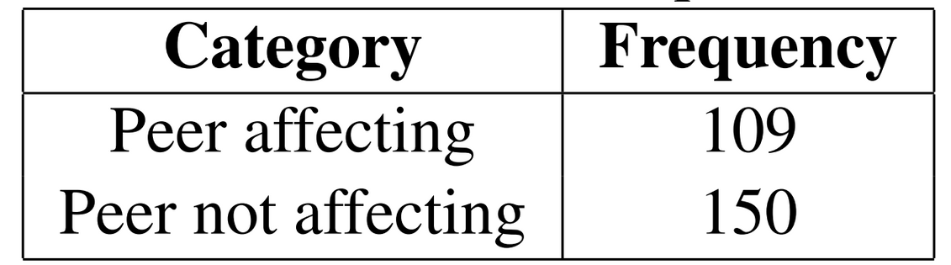
Chi Squared Test to check if peers influence people going to class
Null Hypothesis:
Alternate Hypothesis:
Where p1 and p2 represent the probabilities of individual going to classes depending on peers.

Slide 37
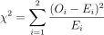
Chi Squared Test to check if peers influence people going to class
We calculate :
Where Ei is the expected frequency and Oi is the original frequency.
We obtain :
Therefore, we reject the null hypothesis.

Slide 38
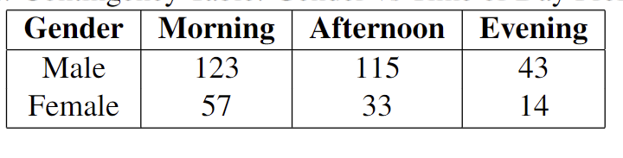
Chi-Squared Test for gender-wise preference time of attending classes
Null Hypothesis:
There is no association between Gender and class time preferences.
Alternate Hypothesis:
There is association between Gender and class time preferences.

Slide 39
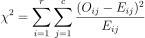
Chi-Squared Test for gender-wise preference time of attending classes
We calculate :
Where Ei is the expected frequency and Oi is the original frequency.
We obtain :
Therefore, we fail to reject the null hypothesis.

Slide 40
CONCLUSIONS

Slide 41
The correlation coefficient between the number of courses registered and attendance indicates a high correlation, with a value of approximately 0.8.
The correlation between attendance and CGPA is negligible, with a very small correlation coefficient of around 0.2.
The introduction of attendance app has been successful, as evidenced by increased class attendance compared to before, as supported by hypothesis testing.
Conclusions

Slide 42
The variation in the number of courses taken by first and second-year students is considerably lower compared to the variation observed in third and fourth-year students.
More than 33% of students are influenced by their low exam marks and are motivated to attend more classes.
Peers significantly influence a student's attendance in class.
The average wake-up time is 7:58 am, which is conducive to establishing a healthy routine for attending classes throughout the day.
Conclusions

Slide 43

THANK YOU!
Scan this code to access the GitHub repository.

